Slide 1

CYBERROOKIE

Slide 2
Learning Hands-on Skills With CyberRookie
Trevor Shi

Slide 3
Introdution
About Me
1. Have 3 Years IT work experience and 3 years IT career gap
2. CISSP\Qualys VM\CSX Cyber Fundamentals
3. A CyberSecurity Learner
4. A English Learner

Slide 4
Introdution
About CyberRookie
1. A self-studying group
2. Help people who without IT Cyber background into IT or cyber
field
3. Learning hands-on skills from free resources and open-source
security software

Slide 5

CyberSecurity Perspective

Slide 6
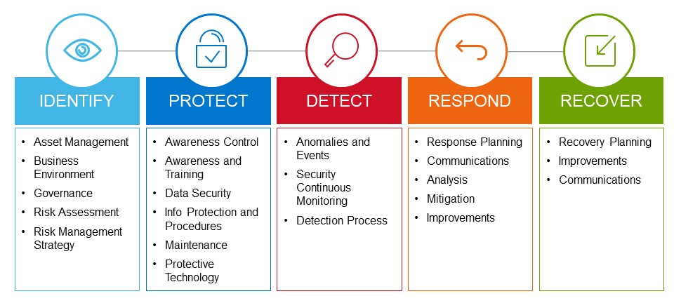
NIST Cybersecurity Framework

Slide 7
Plan
Our goals
1. Learning hands-on skills from free resources and open-source
security software in defensive security
2. Find out a effective way to run CyberRookie
3. Get IT / Cyber Certification
4. To be quality entre-level cybersecurity analyst

Slide 8
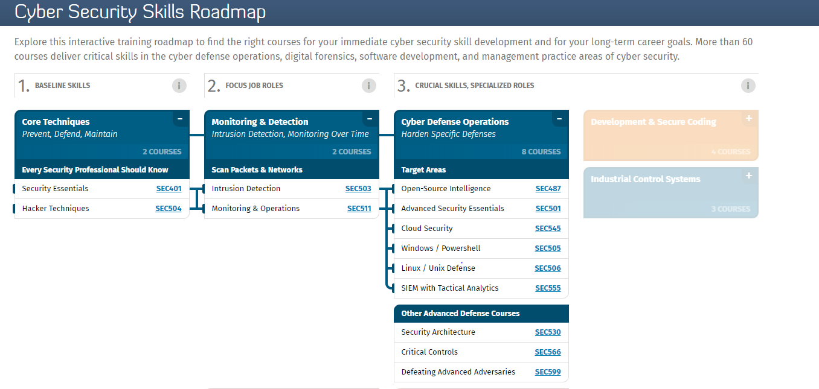

Slide 9
Plan
Our goals
1. Learning hands-on skills from free resources and open-source
security software in defensive security
2. Find out a effective way to run CyberRookie
3. Get some IT / Cyber Certification

Slide 10
Plan
What we will learn
1. Virtualization, Network/System Administration
2. Secure architecture
3. Prevention, Detection & Response
4. Firewall, IDS/IPS
5. Network Monitoring System
6. Security Monitoring System
7. Risk Assessment
8. SEIM

Slide 11
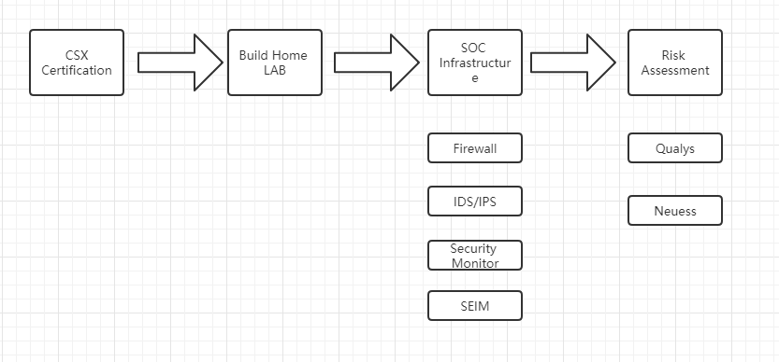
Plan
What we will learn(4 months project)
Qualys Certification
Neuess Certification
Splunks Certification

Slide 12
Plan
My Role
1. A CyberRookie Member\Organizer, not manager
2. A CyberRookie Co-Learner, not instructor
3. A Person who is looking for like-minded friends to learn Cyber
4. A Person who is looking for like-minded friends to learn Cyber

Slide 13
Plan
What I am doing for CyberRookie
CSX study materials
CyberRookie Learning materials
CyberRookie Documentation
CyberRookie Development Planning

Slide 14
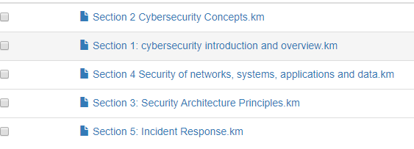
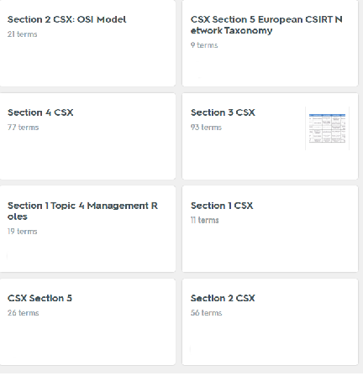
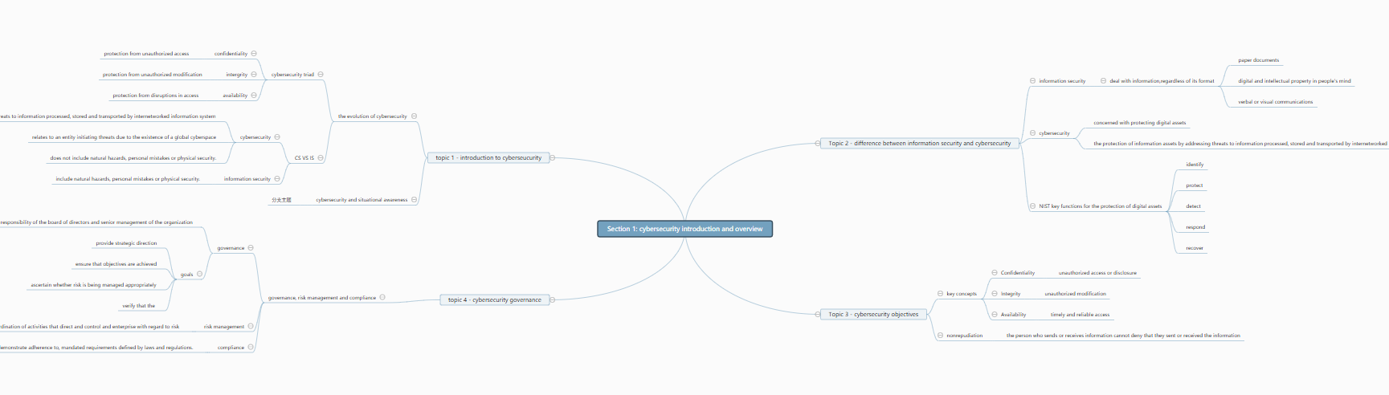
What I am doing for CyberRookie
CSX study materials

Slide 15
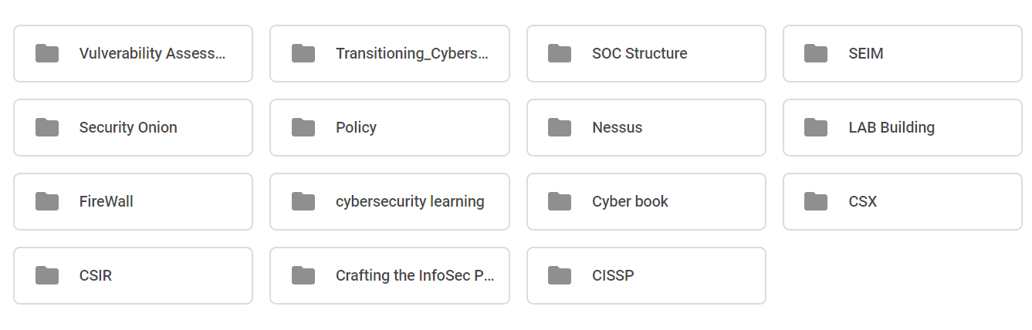
What I am doing for CyberRookie
CyberRookie Learning materials

Slide 16
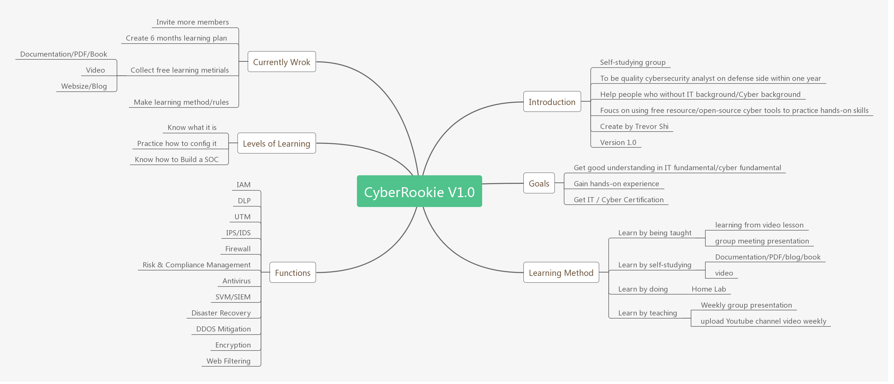
What I am doing for CyberRookie
CyberRookie Doucumentation

Slide 17
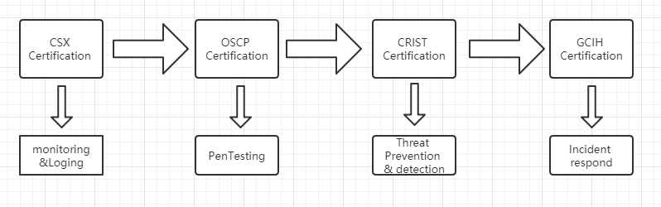
Plan
My 2 years goals

Slide 18
What else we need to do in CyberRookie
1. Enjoy Learning
2. Active participation
3. Doucument anything
4. Advertise CyberRookie

Slide 19
Q&A

Slide 20
Thank You

